Slide 1
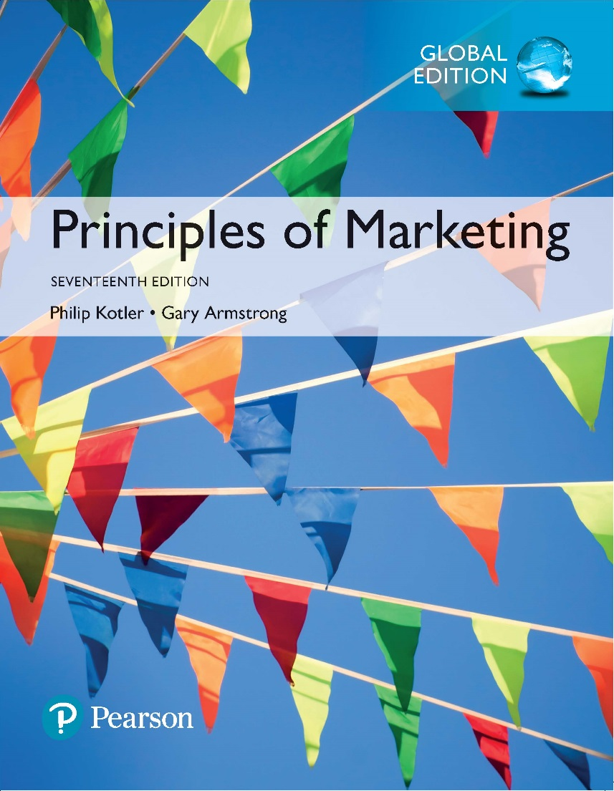
Principles of Marketing Seventeenth Edition
Chapter 2 Partnering to Build Customer Engagement, Value, and Relationships
Copyright © 2018 Pearson Education Ltd. All Rights Reserved.

Slide 2
Learning Objectives
2-1 Explain company-wide strategic planning and its four steps.
2-2 Discuss how to design business portfolios and develop growth strategies.
2-3 Explain marketing’s role in strategic planning and how marketing works with its partners to create and deliver customer value.
2-4 Describe the elements of a customer value-driven marketing strategy and mix, and the forces that influence it.
2-5 List the marketing management functions, including the elements of a marketing plan, and discuss the importance of measuring and managing marketing return on investment.

Slide 3
Learning Objective 1
Explain company-wide strategic planning and its four steps.

Slide 4
Company-Wide Strategic Planning (1 of 3)
Strategic planning is the process of developing and maintaining a strategic fit between the organization’s goals and capabilities, and its changing marketing opportunities.
Notes:
Discussion Question
How might the strategic plan of the college or university influence decisions in the school’s programs and offerings? How might it influence decisions in food services, dormitories, executive education, and undergraduate versus graduate programs?
Strategic planning sets the stage for the rest of planning in the firm. Companies usually prepare annual plans, long-range plans, and strategic plans.
The annual and long-range plans deal with the company’s current businesses and how to keep them going.
In contrast, the strategic plan involves adapting the firm to take advantage of opportunities in its constantly changing environment.

Slide 5
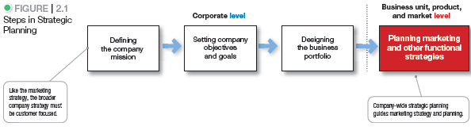
Company-Wide Strategic Planning
Notes:
At the corporate level, the company starts the strategic planning process by defining its overall purpose and mission (see Figure 2.1).
This mission is then turned into detailed supporting objectives that guide the entire company. Next, headquarters decides what portfolio of businesses and products is best for the company and how much support to give each one. In turn, each business and product develops detailed marketing and other departmental plans that support the company-wide plan.
Thus, marketing planning occurs at the business-unit, product, and market levels.
It supports company strategic planning with more detailed plans for specific marketing opportunities.

Slide 6
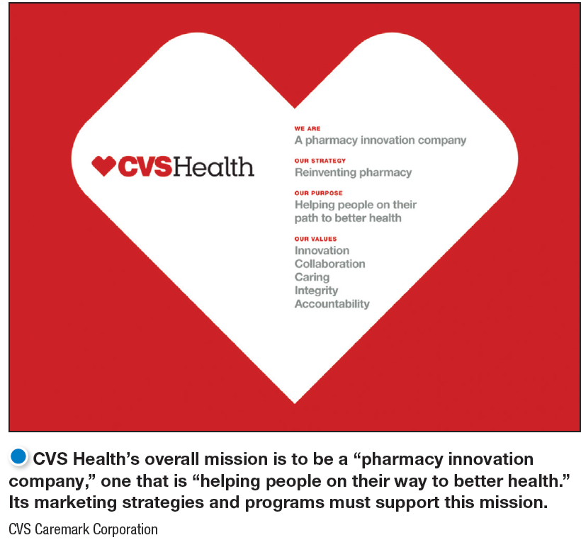
Company-Wide Strategic Planning
The mission statement is the organization’s purpose; what it wants to accomplish in the larger environment.
Notes:
Forging a sound mission begins with the following questions:
What is our business?
Who is the customer?
What do consumers value?
What should our business be?
These simple-sounding questions are among the most difficult the company will ever have to answer. Successful companies continuously raise these questions and answer them carefully and completely.
A mission statement should:
Not be myopic in product terms
Be meaningful and specific
Be motivating
Emphasize the company’s strengths
Contain specific workable guidelines
Not be stated as making sales or profits
Discussion Question
A market-oriented mission statement defines the business in terms of satisfying basic customer needs. Ask the students to evaluate how the IBM mission statement meets the criteria of a market-oriented mission statement.

Slide 7
Company-Wide Strategic Planning
Setting Company Objectives and Goals
Business objectives
Build profitable customer relationships
Invest in research
Improve profits
Marketing objectives
Increase market share
Create local partnerships
Increase promotion
Notes:
The company needs to turn its mission into detailed supporting objectives for each level of management. Each manager should have objectives and be responsible for reaching them.
The company can tie a diverse product portfolio together under a mission.
This broad mission leads to a hierarchy of objectives, including business objectives and marketing objectives such as to build profitable customer relationships by developing superior products.

Slide 8
Learning Objective 2
Discuss how to design business portfolios and develop growth strategies.

Slide 9
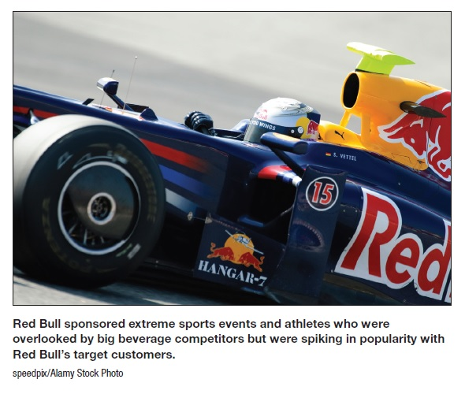
Designing The Business Portfolio
The business portfolio is the collection of businesses and products that make up the company.
Portfolio analysis is a major activity in strategic planning whereby management evaluates the products and businesses that make up the company.
Notes:
The best business portfolio is the one that best fits the company’s strengths and weaknesses to opportunities in the environment.
Business portfolio planning involves two steps. First, the company must analyze its current business portfolio and determine which businesses should receive more, less, or no investment. Second, it must shape the future portfolio by developing strategies for growth and downsizing.

Slide 10
Designing The Business Portfolio
Strategic business units can be a
Company division
Product line within a division
Single product or brand

Slide 11
Designing The Business Portfolio
Analyzing The Current Business Portfolio
Identify strategic business units (SBUs)
Assess the attractiveness of its various SBUs
Decide how much support each SBU deserves
Notes:
When designing a business portfolio, it’s a good idea to add and support products and businesses that fit closely with the firm’s core philosophy and competencies.
The purpose of strategic planning is to find ways in which the company can best use its strengths to take advantage of attractive opportunities in the environment.
For this reason, most standard portfolio analysis methods evaluate SBUs on two important dimensions: the attractiveness of the SBU’s market or industry and the strength of the SBU’s position in that market or industry.

Slide 12
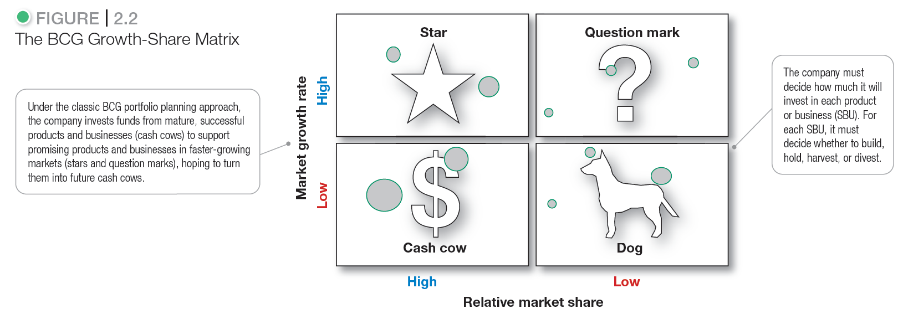
Designing The Business Portfolio
Notes:
Discussion Question
Ask the students to suggest product categories that might fit in each of the BCG quadrants.
The best-known portfolio-planning method is the now-classic Boston Consulting Group (BCG) approach. The growth-share matrix defines four types of SBUs.
Stars are high-growth, high-share businesses or products requiring heavy investment to finance rapid growth. They will eventually turn into cash cows.
Cash cows are low-growth, high-share businesses or products that are established and successful SBUs requiring less investment to maintain market share.
Question marks are low-share business units in high-growth markets requiring a lot of cash to hold their share.
Dogs are low-growth, low-share businesses and products that may generate enough cash to maintain themselves but do not promise to be large sources of cash.

Slide 13
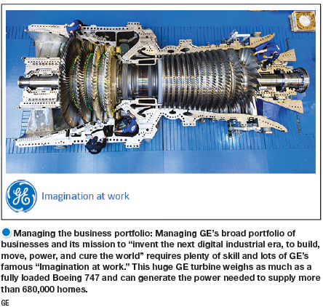
Designing The Business Portfolio
Problems with Matrix Approaches
Difficulty in defining SBUs and measuring market share and growth
Time consuming
Expensive
Focus on current businesses, not future planning
Notes:
Because of these problems, many companies have dropped formal matrix methods in favor of more customized approaches that better suit their specific situations.
Increasingly, companies are placing responsibility for strategic planning in the hands of cross-functional teams of divisional managers who are close to their markets.

Slide 14
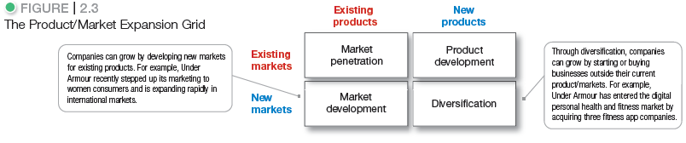
Designing The Business Portfolio
Notes:
Marketing needs to identify, evaluate, and select market opportunities and establish strategies for capturing them. One useful device for identifying growth opportunities is the product/market expansion grid, Figure 2.3.
Market penetration involves making more sales to current customers without changing its original product such as by adding new stores in current market areas to make it easier for customers to visit.
Market development involves identifying and developing new markets for its current products. For instance, managers could review new demographic markets. Perhaps new groups—such as seniors—could be encouraged. Managers could consider new geographic markets in U.S. markets and in non-U.S. markets, especially Asia.
Product development involves offering modified or new products to current markets such as by moving into new product categories.
Diversification involves starting up or buying businesses beyond its current products and markets. For example, the company could acquire a company that operates in different market segments with a different product mix.

Slide 15

Designing The Business Portfolio
Developing Strategies for Growth and Downsizing
Notes:
The figure: To increase sales Under Armour has entered new market (women) applying market development strategy.
Market offerings include other entities, such as persons, places, organizations, information, and ideas.
Many sellers suffer from marketing myopia, the mistake of paying more attention to the specific products they offer than to the benefits and experiences produced by these products.
Marketing experiences:
More than just a sports bar, Buffalo Wild Wings mission is to provide a total eating and social environment that “fuels the sports fan experience” through in-store and online engagement. Smart marketers orchestrate several services and products, thereby creating brand experiences for consumers.

Slide 16
Designing The Business Portfolio
Developing Strategies for Growth and Downsizing
Downsizing is when a company must prune, harvest, or divest businesses that are unprofitable or that no longer fit the strategy.
Notes:
A firm might want to abandon products or markets for a number of reasons.
The firm may have grown too fast or entered areas where it lacks experience.
The market environment might change, making some products or markets less profitable.
Some products or business units simply age and die.

Slide 17
Learning Objective 3
Explain marketing’s role in strategic planning and how marketing works with its partners to create and deliver customer value.

Slide 18
Planning Marketing: Partnering to Build Customer Relationships (1 of 3)
Marketing role in the company strategic planning
Provides the marketing philosophy (concept) that the company strategy should revolve around.
Provides inputs of strategic planners (e.g. market opportunities).
Designs strategies that each business unit in the company implement to reach its objectives.
Partners with:
Other company department (value chain)
Others in the marketing system (value delivery network)
Notes:
Marketing alone can’t create superior customer value. Under the company-wide strategic plan, marketers must work closely with other departments to form an effective internal company value chain.

Slide 19
Planning Marketing: Partnering to Build Customer Relationships (1 of 3)
Partnering with Other Company Departments
Value chain is a series of departments that carry out value creating activities to design, produce, market, deliver, and support a firm’s products.
Marketing alone can’t create superior customer value. Under the company-wide strategic plan, marketers must work closely with other departments to form an effective internal company value chain.
Notes:
Marketing alone can’t create superior customer value. Under the company-wide strategic plan, marketers must work closely with other departments to form an effective internal company value chain.

Slide 20

Planning Marketing: Partnering to Build Customer Relationships (2 of 3)
Partnering with Other Company Departments
Notes:
Marketing alone can’t create superior customer value. Under the company-wide strategic plan, marketers must work closely with other departments to form an effective internal company value chain.
The value chain: These True Value ads recognize that everyone in the organization—from marketing research analyst Jeff Alvarez to operations manager Tom Statham—must contribute to helping the chain’s customers handle their home improvement projects. They form the foundation for the brand’s “Behind Every Project Is a True Value” positioning.

Slide 21
Planning Marketing: Partnering to Build Customer Relationships (3 of 3)
Partnering with Others in the Marketing System
Value delivery network is made up of the company, suppliers, distributors, and ultimately customers who partner with each other to improve performance of the entire system.
Notes:
More companies today are partnering with other members of the supply to improve the performance of the customer value delivery network.
Competition no longer takes place only between individual competitors. Rather, it takes place between the entire value delivery network created by these competitors.

Slide 22
Learning Objective 4
Describe the elements of a customer value-driven marketing strategy and mix, and the forces that influence it.
Customer-driven marketing strategy
Integrated marketing mix

Slide 23
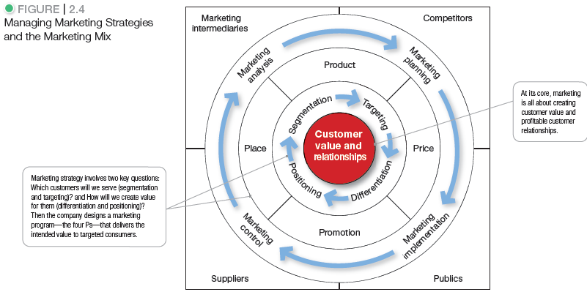
Marketing Strategy and the Marketing Mix
Notes:
Consumers stand in the center of Figure 2.4 where the goal is to create value for customers and build profitable customer relationships.
Next comes marketing strategy—the marketing logic by which the company hopes to create this customer value and achieve these profitable relationships. The company decides which customers it will serve (segmentation and targeting) and how (differentiation and positioning).
Guided by marketing strategy, the company designs an integrated marketing mix made up of factors under its control—product, price, place, and promotion (the four Ps).
To find the best marketing strategy and mix, the company engages in marketing analysis, planning, implementation, and control.
Through these activities, the company watches and adapts to the actors and forces in the marketing environment.

Slide 24
Marketing Strategy and the Marketing Mix
Customer Value-Driven Marketing Strategy
Marketing strategy is the marketing logic by which the company hopes to create customer value and achieve profitable customer relationships.
The company decides which customers it will serve (segmentation and targeting) and how (differentiation and positioning).

Slide 25
Marketing Strategy and the Marketing Mix
Customer Value-Driven Marketing Strategy
Market segmentation is the division of a market into distinct groups of buyers who have different needs, characteristics, or behaviors and who might require separate products or marketing mixes. Market segment is a group of consumers who respond in a similar way to a given set of marketing efforts.
Notes:
The market consists of many types of customers, products, and needs. The marketer must determine which segments offer the best opportunities. Consumers can be grouped and served in various ways based on geographic, demographic, psychographic, and behavioral factors.
Every market has segments, but not all ways of segmenting a market are equally useful. For example, Tylenol would gain little by distinguishing between low-income and high-income pain relief users if both respond the same way to marketing efforts. In the car market, for example, consumers who want the biggest, most comfortable car regardless of price and consumers who care mainly about price and operating economy represent two different segments.
Companies are wise to focus their efforts on meeting the distinct needs of individual market segments.

Slide 26
Marketing Strategy and the Marketing Mix
Customer Value-Driven Marketing Strategy
Market targeting is the process of evaluating each market segment’s attractiveness and selecting one or more segments to enter.
Differentiation begins the positioning process.
Market positioning is the arranging for a product to occupy a clear, distinctive, and desirable place relative to competing products in the minds of target consumers.
Notes:
A company should target segments in which it can profitably generate the greatest customer value and sustain it over time.
A company might decide to serve
only one or a few special segments or market niches, segments that major competitors overlook or ignore.
several related segments—perhaps those with different kinds of customers but with the same basic wants.
all market segments, offering a complete range of products.
Most companies enter a new market by serving a single segment; if this proves successful, they add more segments.
The company must determine how to differentiate its market offering for each targeted segment and what positions it wants to occupy in those segments. A product’s position is the place it occupies relative to competitors’ products in consumers’ minds. Marketers plan positions that distinguish their products from competing brands and give them the greatest advantage in their target markets.

Slide 27
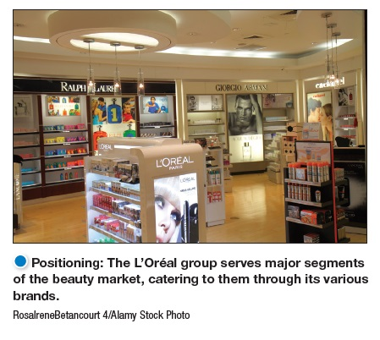
Marketing Strategy and the Marketing Mix
Customer Value-Driven Marketing Strategy
Positioning: The L’Oréal group serves major segments of the beauty market, and within each segment it caters to many sub segments. L’Oréal targets the larger segments through its major divisions; further within these major divisions, L’Oréal markets various brands that cater to customers of different ages, incomes, and lifestyles.

Slide 28
Marketing Strategy and the Marketing Mix
Developing an Integrated Marketing Mix
Marketing mix is the set of controllable, tactical marketing tools—product, price, place, and promotion—that the firm blends to produce the response it wants in the target market.
Notes:
After determining its overall marketing strategy, the company is ready to begin planning the details of the marketing mix, one of the major concepts in modern marketing.
The marketing mix consists of everything the firm can do to influence the demand for its product.

Slide 29
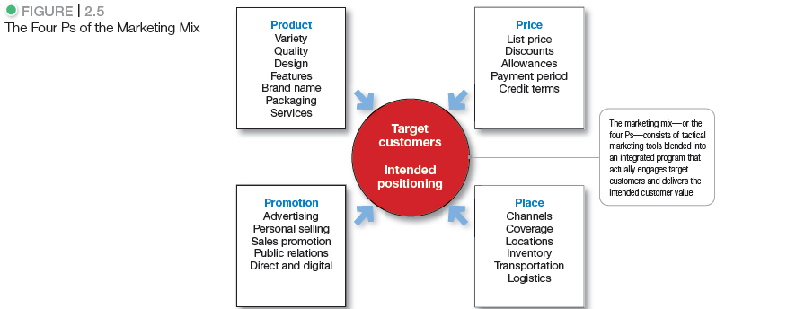
Marketing Strategy and the Marketing Mix
Notes:
The many possibilities can be collected into four groups of variables—the four Ps. Figure 2.5 above shows the marketing tools under each P.
Product means the goods-and-services combination the company offers to the target market.
Price is the amount of money customers must pay to obtain the product.
Place includes company activities that make the product available to target consumers.
Promotion refers to activities that communicate the merits of the product and persuade target customers to buy it.
An effective marketing program blends the marketing mix elements into an integrated marketing program designed to achieve the company’s marketing objectives by delivering value to consumers. The marketing mix constitutes the company’s tactical tool kit for establishing strong positioning in target markets.
Some critics think that the four Ps may omit or underemphasize certain important activities. For example, they ask, “Where are services?” or “Where is packaging?” As Figure 2.5 suggests, many marketing activities that might appear to be left out of the marketing mix are included under one of the four Ps.
The issue is not whether there should be four, six, or ten Ps so much as what framework is most helpful in designing integrated marketing programs.
It is interesting to ask how to make the 4Ps more customer centric. This leads to a redefining of the 4Ps to the 4Cs as follows:
Product—Customer solution
Price—Customer cost
Place—Convenience
Promotion—Communication

Slide 30
Learning Objective 5
List the marketing management functions, including the elements of a marketing plan, and discuss the importance of measuring and managing marketing return on investment.

Slide 31
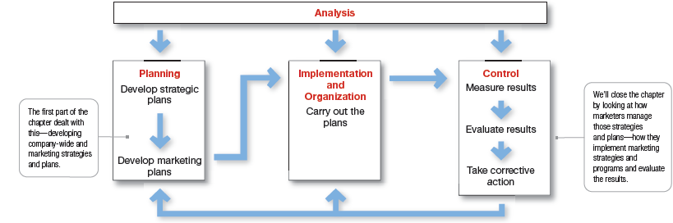
Managing the Marketing Effort
Figure 2.6 Analysis, Planning, Implementation, and Control
Notes:
Managing the marketing process requires the four marketing management functions shown in Figure 2.6—analysis, planning, implementation, and control.
The company first develops company-wide strategic plans and then translates them into marketing and other plans for each division, product, and brand.
Through implementation, the company turns the plans into actions.
Control consists of measuring and evaluating the results of marketing activities and taking corrective action where needed.
Finally, marketing analysis provides information and evaluations needed for all the other marketing activities.

Slide 32
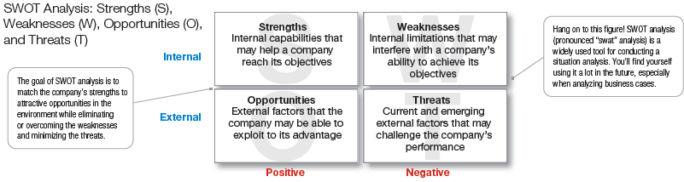
Managing the Marketing Effort
Figure 2.7 Marketing Analysis: SWOT Analysis
Notes:
The company should analyze its markets and marketing environment to find attractive opportunities and identify environmental threats.
It should analyze company strengths and weaknesses as well as current and possible marketing actions to determine which opportunities it can best pursue.
The goal is to match the company’s strengths to attractive opportunities in the environment, while simultaneously eliminating or overcoming the weaknesses and minimizing the threats.
Marketing analysis provides inputs to each of the other marketing management functions.

Slide 33
Managing the Marketing Effort
Market Planning—Parts of a Marketing Plan
Executive summary
Marketing situation
Threats and opportunities
Objectives and issues
Action programs
Budgets
Controls
Marketing strategy
Notes:
Marketing planning involves choosing marketing strategies that will help the company attain its overall strategic objectives. A detailed marketing plan is needed for each business, product, or brand.
What does a marketing plan look like?
Table 2.2 outlines the major sections of a typical product or brand marketing plan.

Slide 34
Managing the Marketing Effort
Marketing Implementation
Turning marketing strategies and plans into marketing actions to accomplish strategic marketing objectives
Addresses who, where, when, and how
Notes:
A brilliant marketing strategy counts for little if the company fails to implement it properly.
Many managers think that “doing things right” (implementation) is as important as, or even more important than, “doing the right things” (strategy).
The fact is that both are critical to success, and companies can gain competitive advantages through effective implementation.

Slide 35
Measuring and Managing Return on Marketing Investment
Marketing Control
Measuring and Managing Return on Marketing Investment (Marketing ROI)
Net return from a marketing investment divided by the costs of the marketing investment
Measurement of the profits generated by investments in marketing activities
Notes:
Measuring return on marketing investment has become a major marketing emphasis.
A company can assess marketing ROI in terms of standard marketing performance measures, such as brand awareness, sales, or market share. Many companies are assembling such measures into marketing dashboards—meaningful sets of marketing performance measures in a single display used to monitor strategic marketing performance.
Increasingly, however, beyond standard performance measures, marketers are using customer-centered measures of marketing impact, such as customer acquisition, customer retention, customer lifetime value, and customer equity.
We can view marketing expenditures as investments that produce returns in the form of more profitable customer relationships.
“In good times and bad, whether or not marketers are ready for it, they’re going to be asked to justify their spending with financial data,” says one marketer. Adds another, marketers “have got to know how to count.”

Slide 36
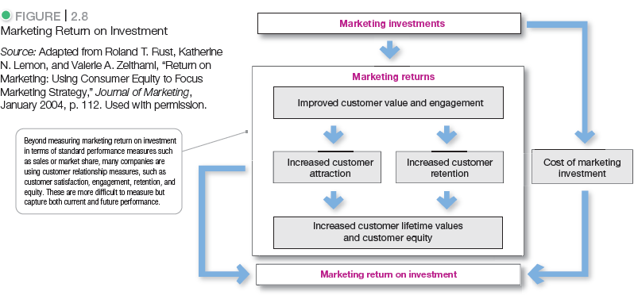
Measuring and Managing Return on Marketing Investment

